Slide 1
EE 295
Final Presentation
Dec 10 , 2019
Zoom Online
Tom Wrappe
EE Lecturer

Slide 2

EE 295
Course:
Name:
Mohammad Asim Sarfraz
Topic
Threat Intelligence in Cyber security (Research)

Slide 3
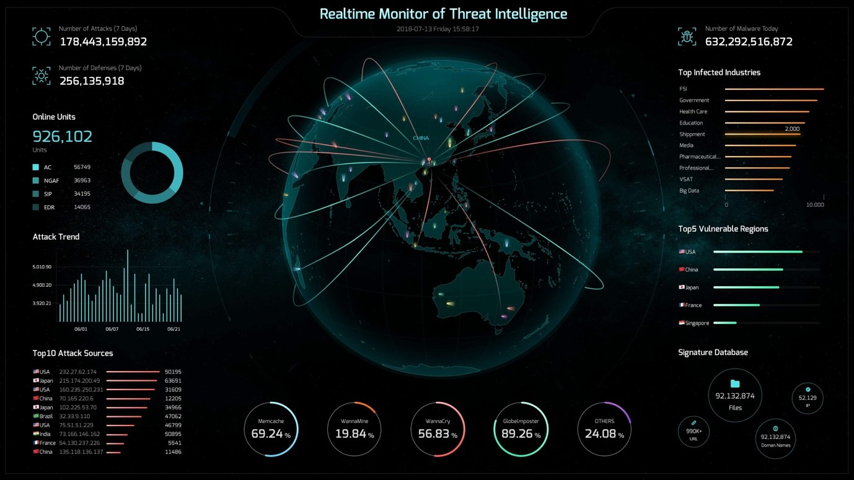
With increasing cyber attacks and frauds a technology that robust defense mechanism is needed.
Threat Intelligence will act on the tactics/procedure and tools used by hackers and will decrease successful cyber attacks and frauds in future.
Figure source: 20180716163623_95858.jpg (1378×775) (sangfor.com)

Slide 4
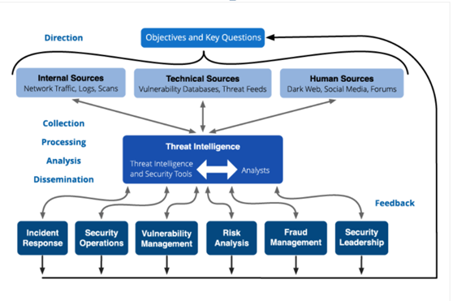
Important aspects of the research. Working, source and use of TI.
The sources of Threat intelligence like dark web, malware analysis, social media etc.
The data is turned to intelligence that is used for defensive mechanism against cyber attacks.
The teams use the intelligence for varying purpose and make an organization strong.
Figure source: threat-intelligence-lifecycle-phases-1.png (900×600) (recordedfuture.com)

Slide 5
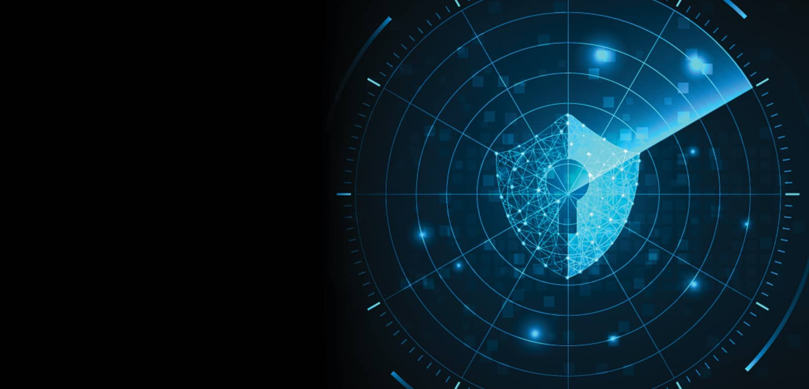
The Key takeaway from research paper
How these threat intelligence/data is made and what are the sources?
How a small indicator of threat can be used to find out the whole history of the attack and the method/tactics/procedure used by hackers?
A practical investigation is done on real TIP platform and found evidences of real cyber attack "emotet" happened in 2019.
How organization especially 'banking' related use this technology for brand reputation, vulnerability management, data leaks, fraud and risk analysis, incident response etc ?

Slide 6
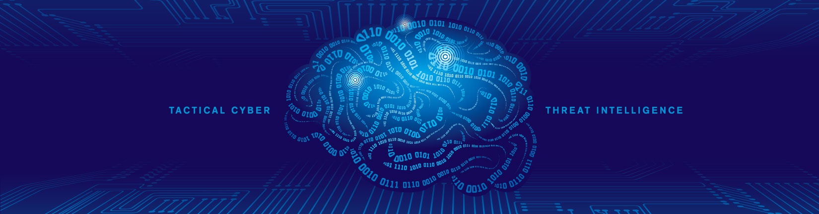
Recommendations
How data from dark web/forums(about hackers activities, data leak and malicious content) can be fetched with more exposure and more effective intelligence can be made.
How intelligence data sharing amongst organizations can be enhanced to follow a military concept of forming an ally against a single hacker/attack group.

Slide 7
Thank you

